Slide 1
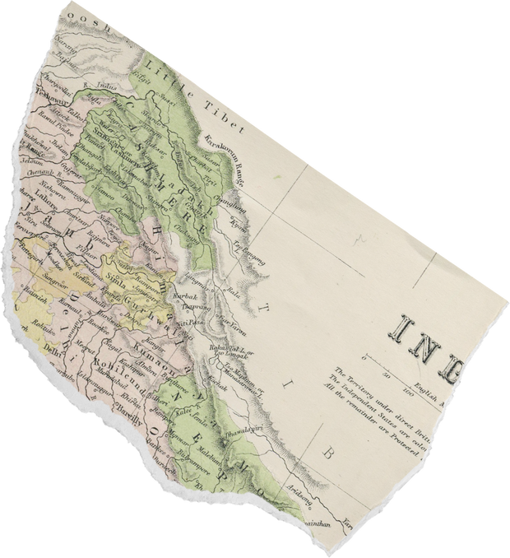
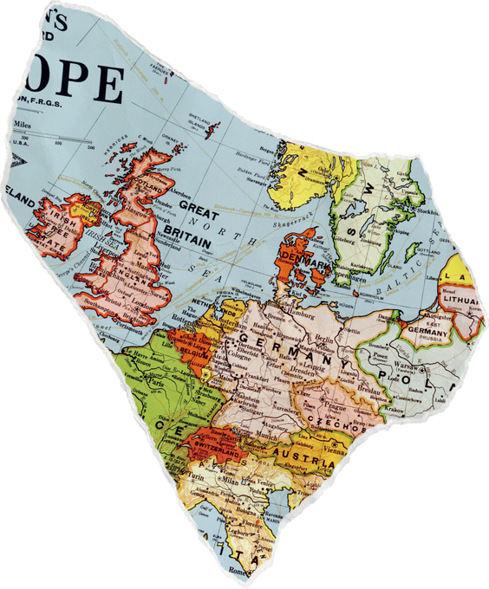
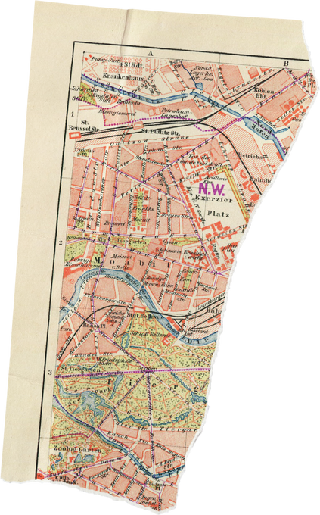
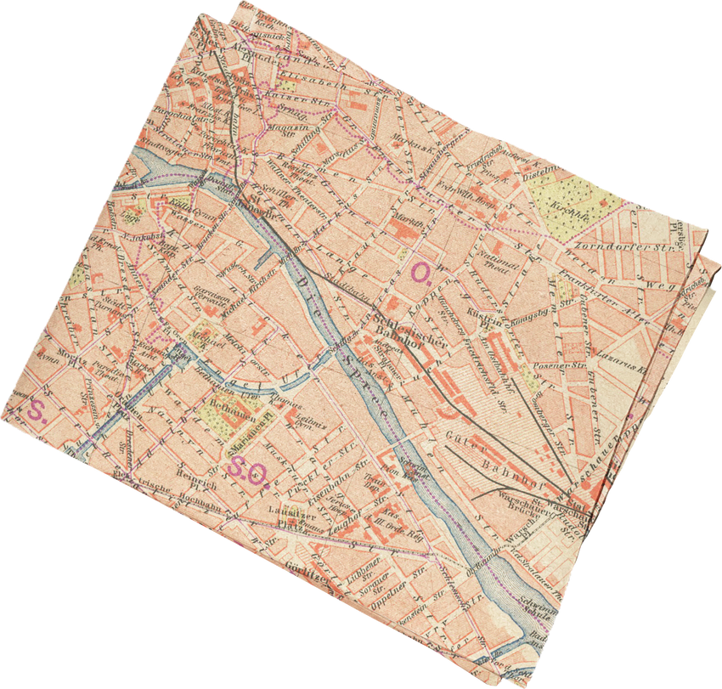
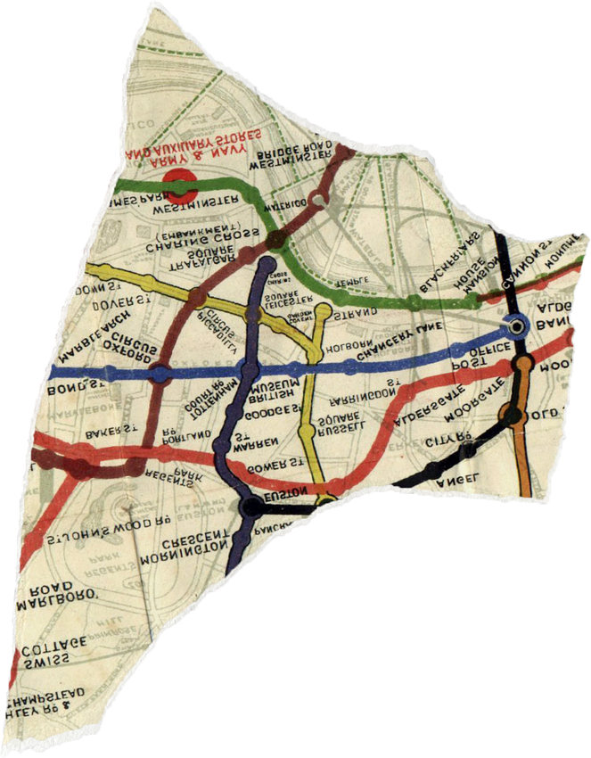
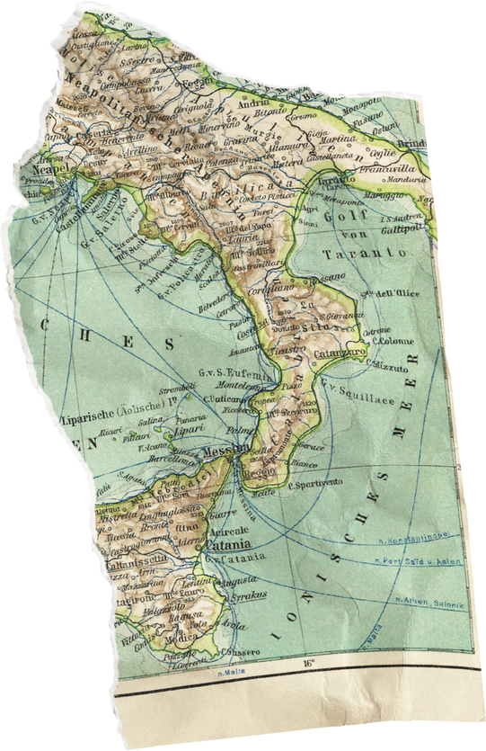

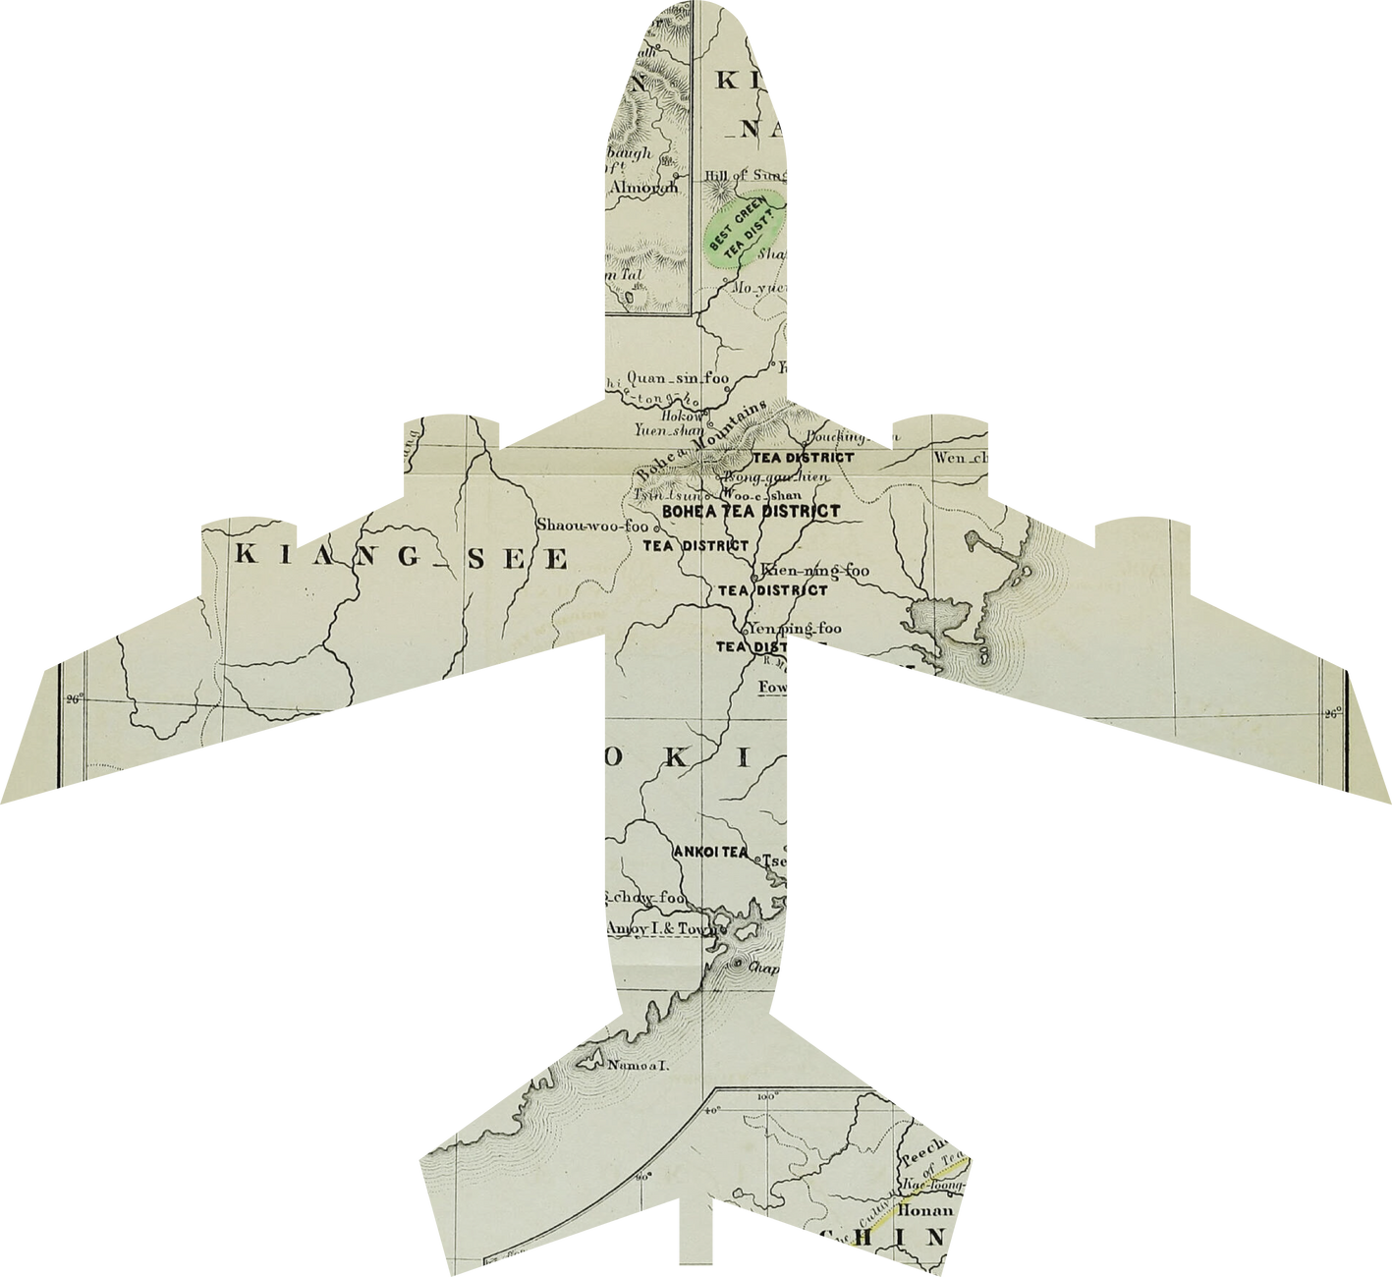
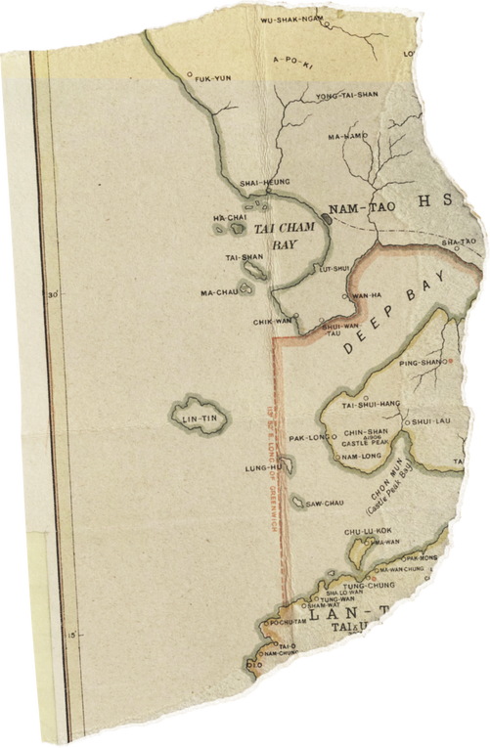

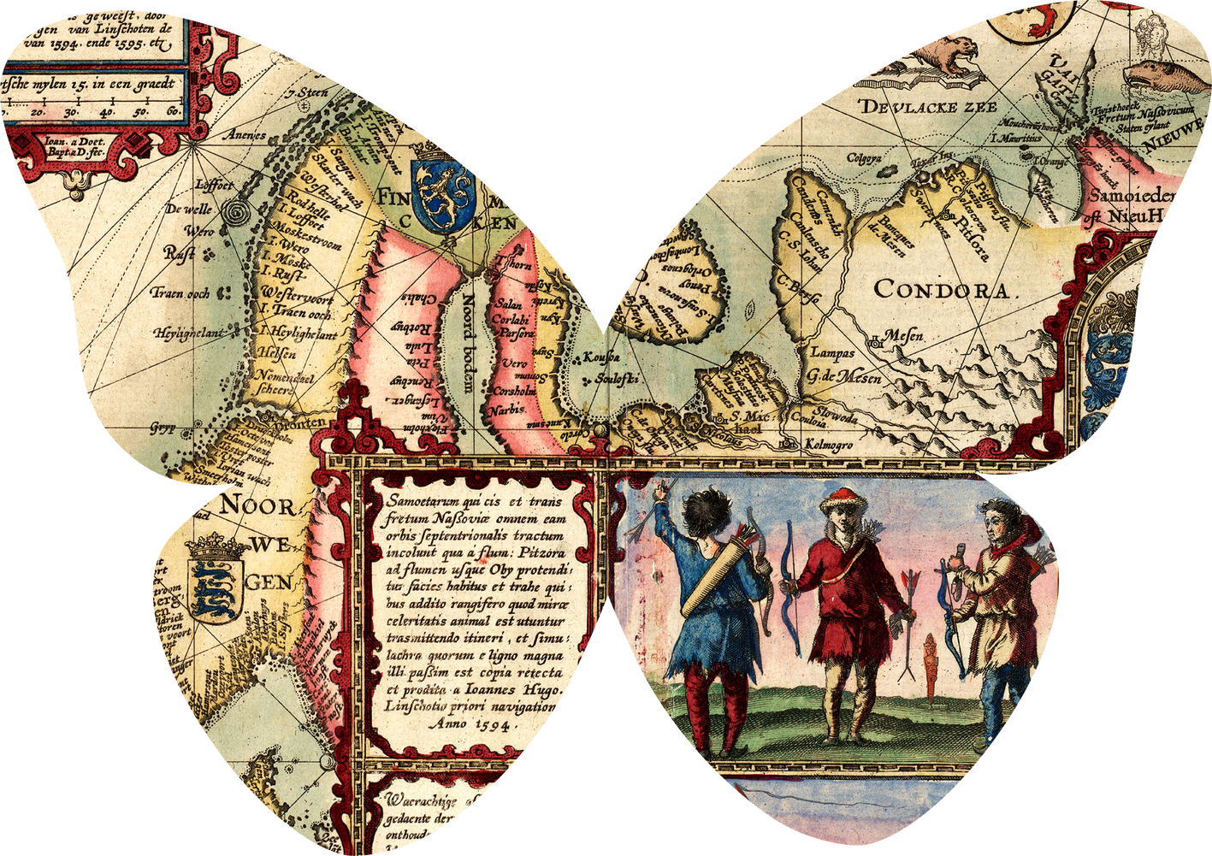
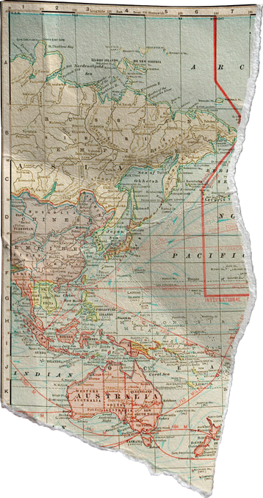
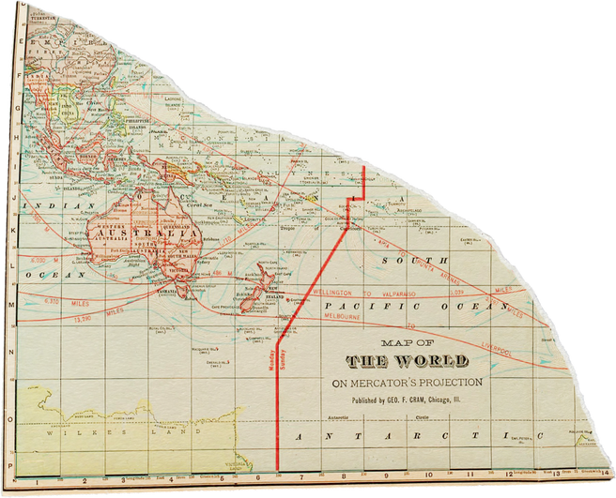

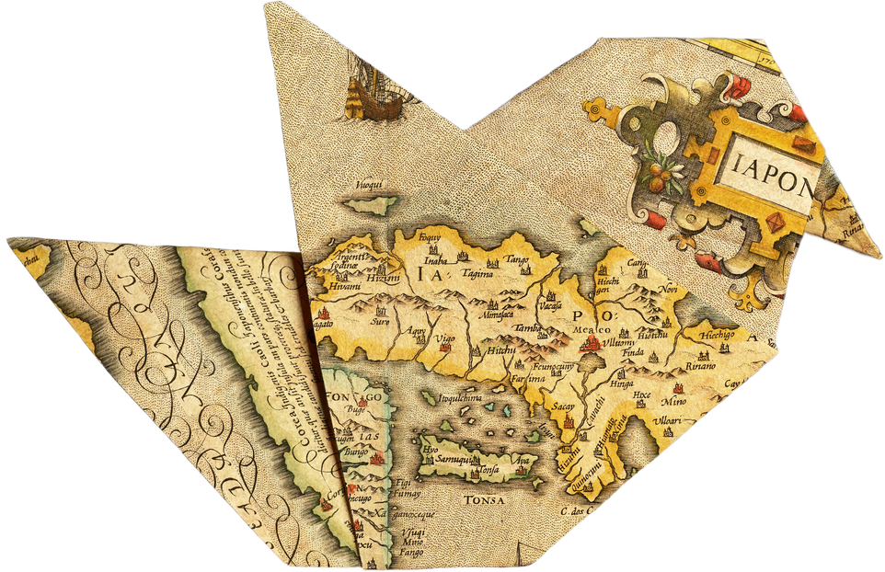
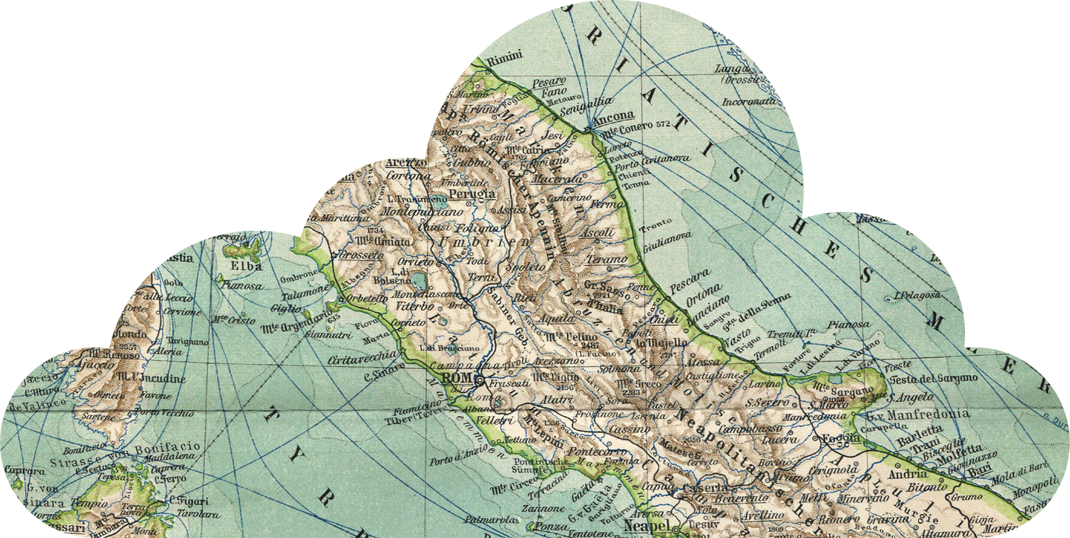
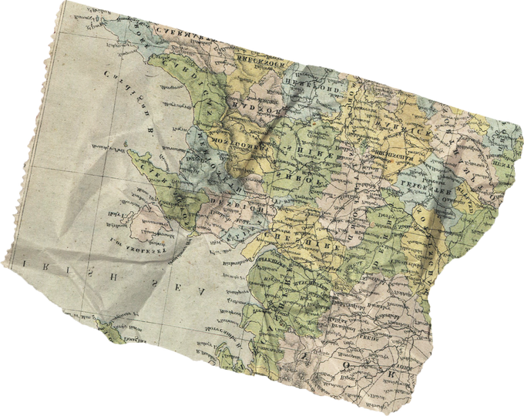
TravelMate
Your Virtual Travel Assistant
Created by Group 9
Archit Pradip Murgudkar
Jyoti Khurana
Kaniz Fatema Mithun
Molly Dignan
Suyash Santosh Tapase

Slide 2

Introduction:
TravelMate is a virtual travel assistant that helps users plan trips by providing personalized itineraries, budgeting, and suggestions.
Problem Solved: Planning a trip can be complex, especially when dealing with language barriers. TravelMate simplifies this process by generating AI-driven trip plans in multiple languages
Tech Stack:
Streamlit for the front-end user interface
Google Generative AI (Gemini) for conversation generation
GoogleTranslator & Deep Translator for language translation
.

Slide 3
Project Objectives
Streamline trip planning with AI-generated (realistic) itineraries based on user preferences.
01.
Multilingual support to eliminate language barriers in the planning process.
02.
Personalized recommendations for activities, accommodation, and budgeting.
03.
User firendly and interactive interface enabling follow-up questions and detailed responses
04.

Slide 4

Project Phases
1. Research:
We identified the need for a travel planning app benefiting
a wide audience using NLP and AI.
2. Design:
We created a user-centric, responsive interface optimized for ease of use across devices.
3. Implementation:
Developed backend with Google AI integration and multilingual support for personalized travel itineraries.
4. Deployment:
Deployed via Streamlit Cloud with seamless scalability and GitHub integration for future updates.

Slide 5
Core Features
Multi-Language Support:
Users can select from multiple languages (English, Hindi, French, Spanish, German, Italian).
Interactive User Interface:
A clean, simple UI allows users to input trip details for generating comprehensive travel plans.
Dynamic Chat History:
The app stores a history of all user interactions, allowing for easy reference and continuity in travel planning.
Integration with Google Generative AI:
Utilizes Google Generative AI to create personalized travel itineraries based on user input, ensuring up-to-date, customized suggestions.

Slide 6
Data Sources
The data for the TravelMate application is obtained through API integration, primarily using Google Generative AI.
Real-Time Data: APIs enable the app to fetch up-to-date information on accommodation availability and prices, ensuring the travel itineraries are relevant to the user’s specified budget and trip duration
.
Dynamic Updates: Unlike static data sources like CSV files, APIs allow real-time adjustments, meaning there is no need for manual updates to reflect changes in availability or prices.

Slide 7

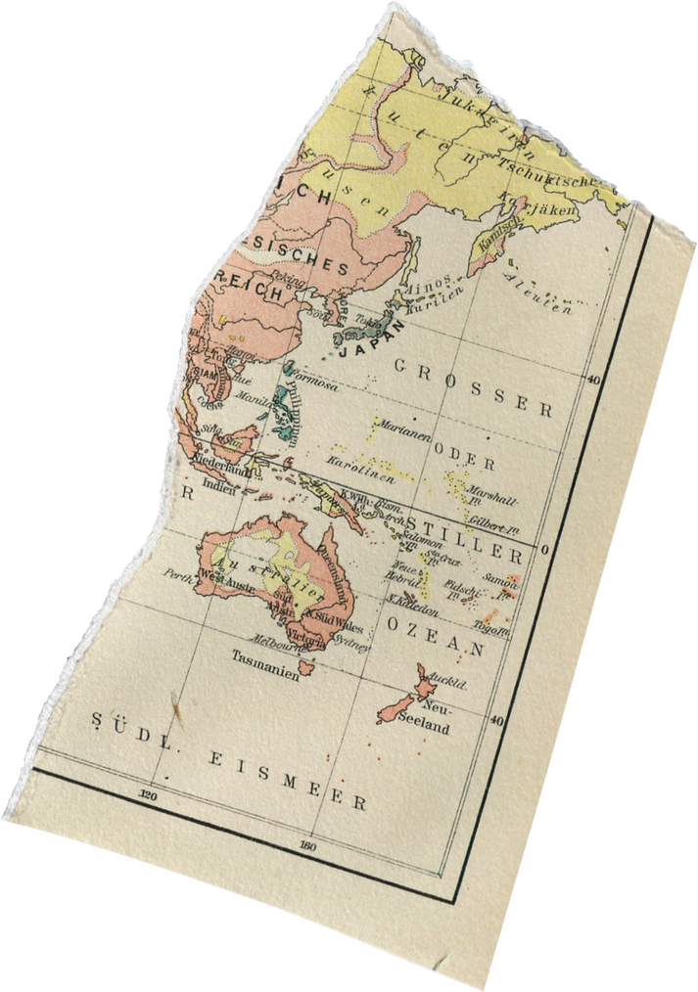
User Interface
Users can input trip details such as destination, duration, budget, and activities. The application supports multiple languages for a global audience
https://travelmate.streamlit.app/

Slide 8
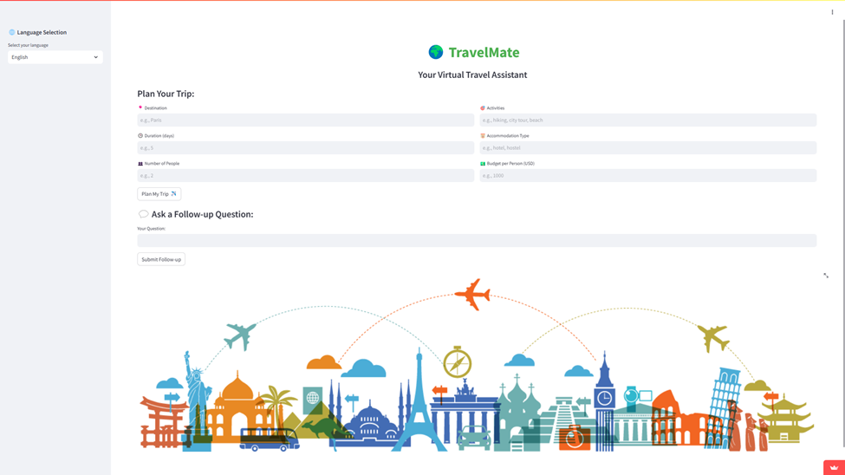
User Interface

Slide 9
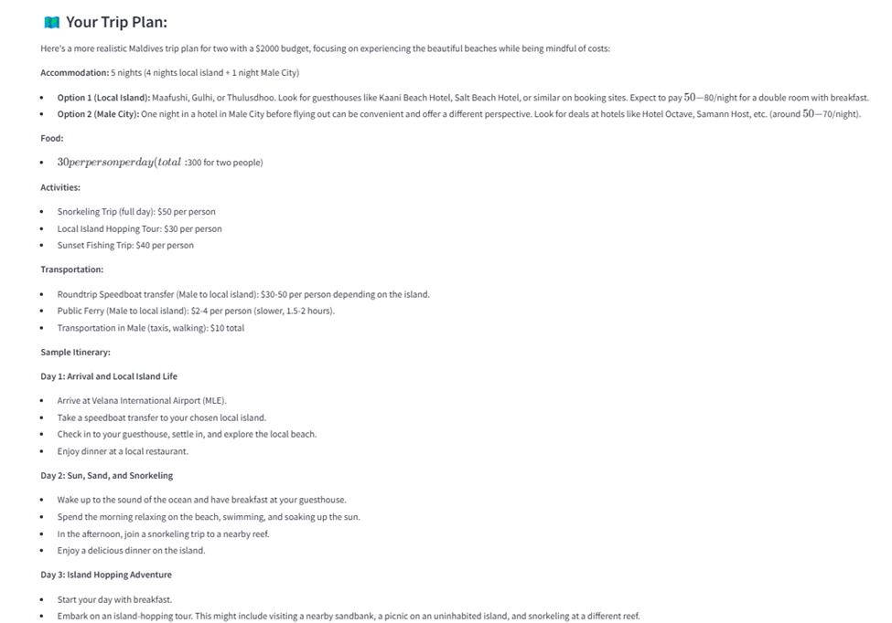

User Interface

Slide 10
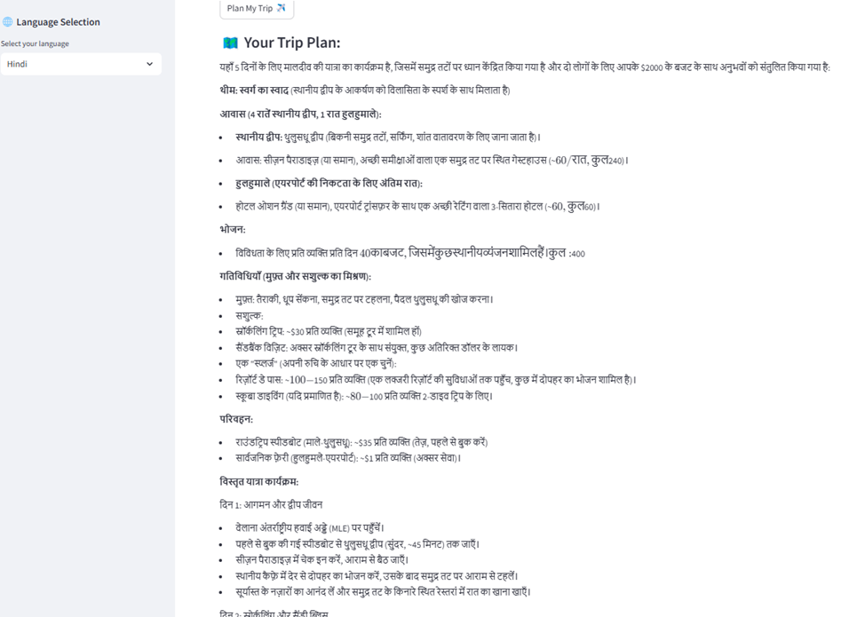

User Interface

Slide 11


Future Enhancements
Adding travel APIs for live flight booking.
Integrating weather and local event suggestions

Slide 12
Conclusion
TravelMate offers a simple and intuitive way to plan trips using AI and multilingual support. It provides users with an easy-to-use interface, personalized travel recommendations, and the ability to ask follow-up questions to fine-tune their trips.

Slide 13

Thank You

Slide 14
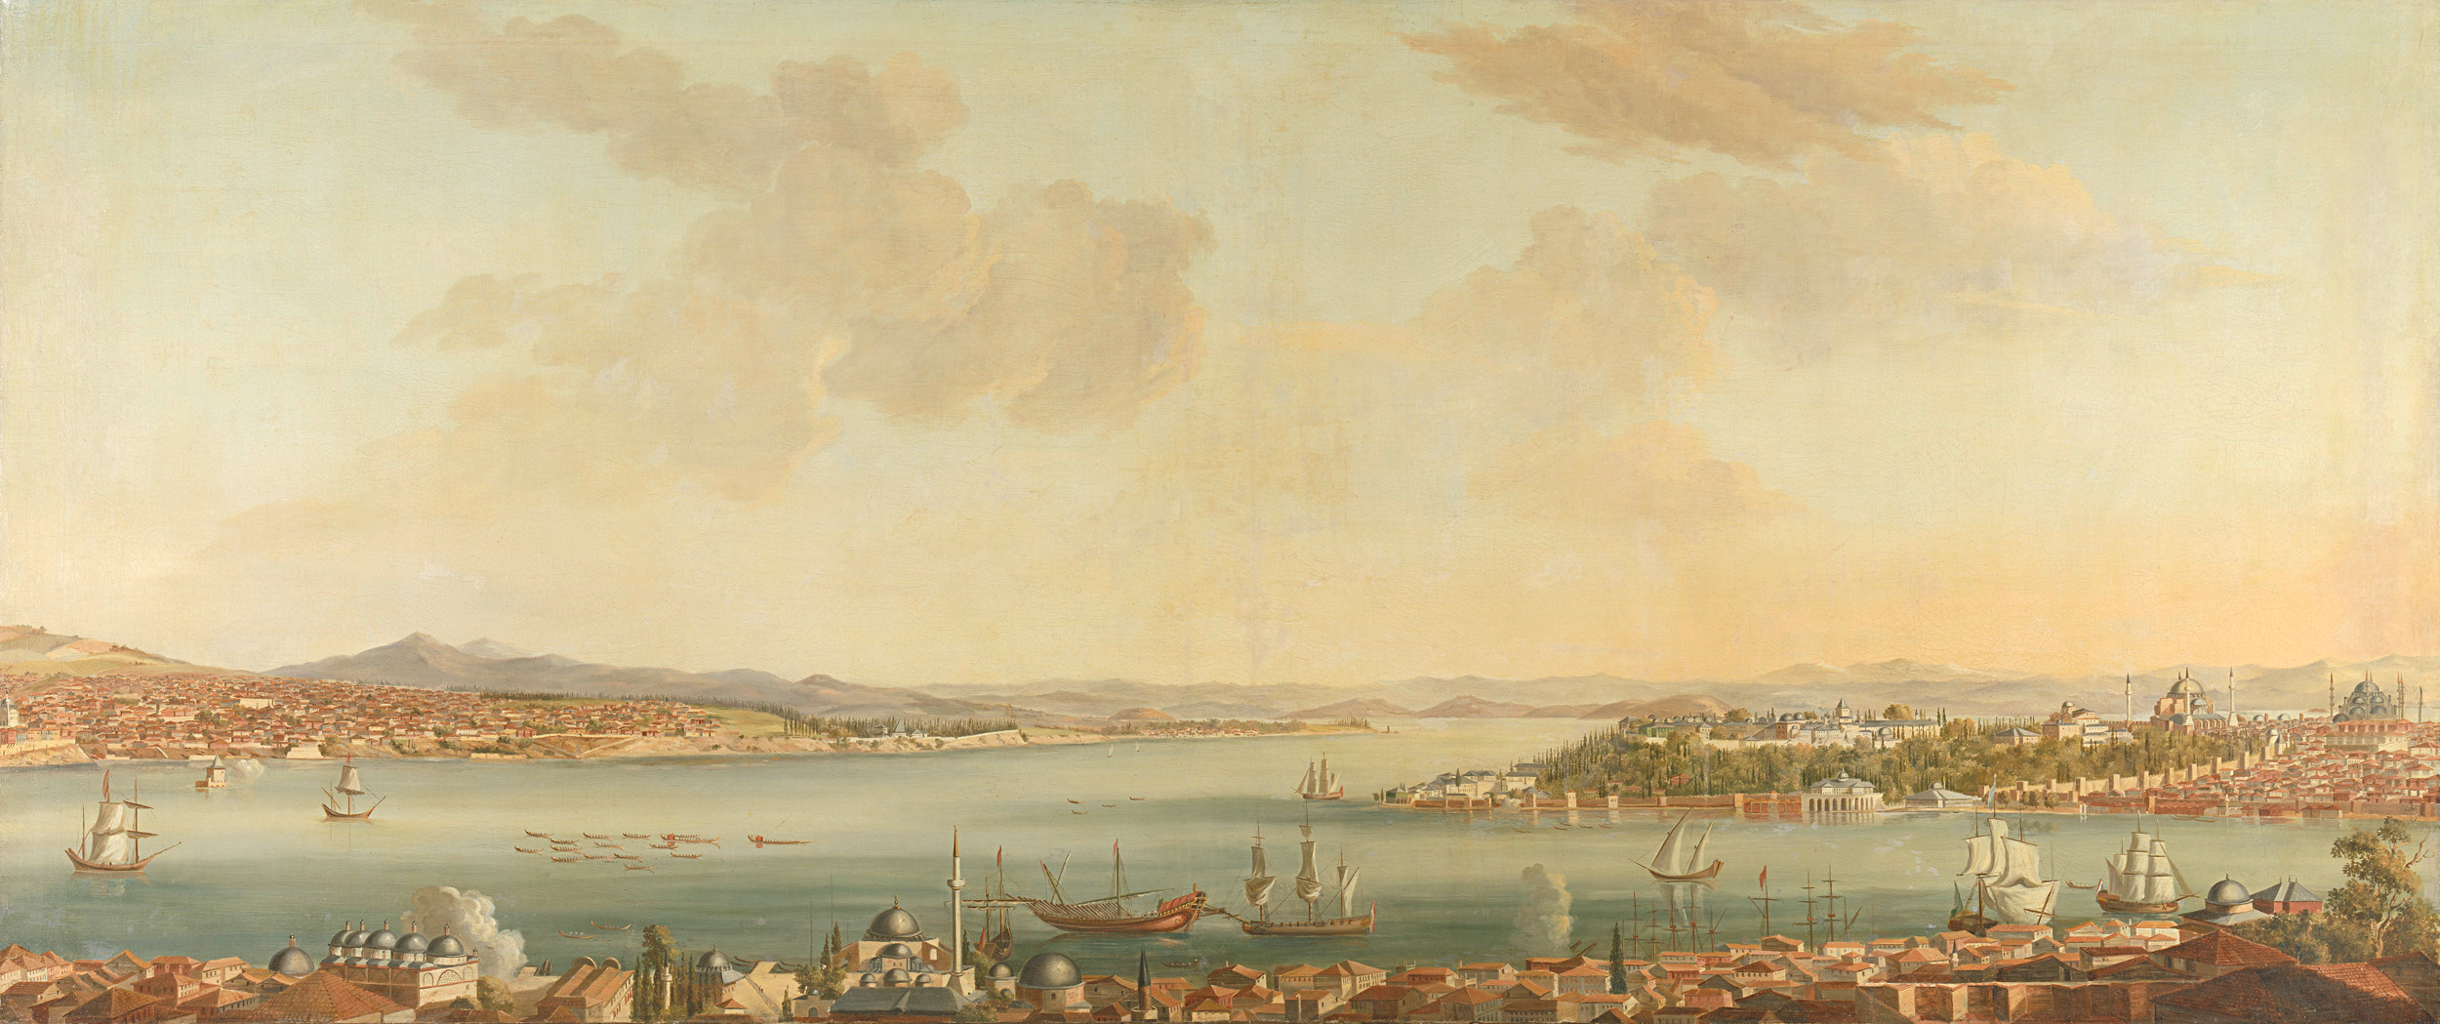


Feel Free to Try Out
TravelMate

